Slide 1
Tech Leadership program
Module-1

Slide 2
Task 1, subtask 1.1
Detailed log decision can be found at marllonsimoes/tech-leadership-prog (github.com)
Sub-task 1.1 - analyse requirements
Read the requirements below
Build a list of any gaps/unclear requirements
Requirements
Development team is going to elaborate REST Service manipulating Event resource. Event entity contains following fields:
id
Title
Place
Speaker
eventType
dateTime
Team leader should choose the most suitable data storage implementation for REST Service providing following functionality:
CRUD operations
Filtering
Search
Sorting
Aggregation by specified field value
Take into account the following:
Data storage for REST service should provide support multi-tenant content storage.
Data Storage should scale so that: up to 100 000 000 of records are stored
CRUD operations and typical search queries should execute within 1 second
Data storage should support automated data backup every 30 days.
Event Model for Data Storage Schema mapping complexity should be minimized.
Data storage should support detailed logging for troubleshooting.
The infrastructure should support two European regions: east and west.

Slide 3
Subtask 1.1 – Gaps identified
There is no information about login/pii or security in this service, only that it should support multi-tenant.
The model, even though it’s not explicitly disclosed, is quite understandable and the field types can be inferred, however, clarification would be needed.
Even though it’s not disclosed, it seems the application will run on a cloud environment. The fact that it requires 2 different zones to run but no clarification on what it means exactly (cloud, hybrid, multi-cloud, cluster made of 2 different AZs) makes it difficult to assure the solution without too many changes.

Slide 4






Subtask 1.1 - Rationale
Points taken into consideration
Flexibility
dev environment with same capabilities as production
no vendor lockin
migration to a different platform
Community
pontual paid support (to reduce costs)
other components that can be part of the ecosystem
previous knowledge/experience
Application requirements
CRUD operations
Filtering
Search
Sorting
Aggregation by specified field value
Data storage for REST service should provide support multi-tenant content storage.
Data Storage should scale so that:
up to 100 000 000 of records are stored
CRUD operations and typical search queries should execute within 1 second
The infrastructure should support two European regions: east and west.

Slide 5
Subtask 1.1 - Decision
PgSQL offers indexes, partitions, and other techniques to segregate the data based on any need users may have.
PgSQL offers several different tools to perform backups, dumps and copy of data to a file or another database
PgSQL has integration with OS events and can be monitored using available market tools such as Prometheus, Zabbix, new relic and others
Despite the fact this requirement is not yet as clear, PgSQL can be depoyed and replicated manually to as many instances as required. When it comes to Distributed database (if this would be the way to go with this requirement), cockroachdb might be the optimal option for such case. It can be replicated between regions, zones, bare-metal or cloud.
When it comes to team knowledge, pgsql, mysql, mongodb are in the top of the list.
Given the requirements, budget, extensibility, the possibility of migration to a different platform, and the involvement of other teams, we chose Postgresql as a database storage because of:
The dev environment can be very similar to production, given a sample of production data
no vendor lock-in as it doesn´t require any proprietary technology or language or platform to execute maintenance. Scripts and data can be migrated to any other provider that supports market standards.
The community is big enough and very active
offers support plans and there are plenty of evangelists here and there who can also offer support
it is the core of several different RDBMS such as cockroach db, yugabyteDB, and others, that provide distributed scalability.

Slide 6
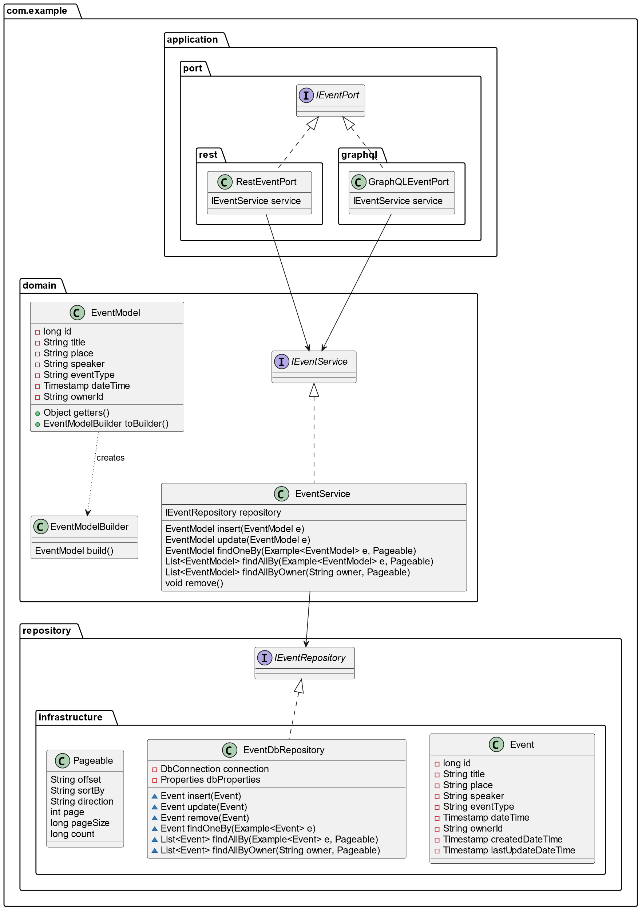
Subtask 1.2 - Components
Rest service will follow the onion architecture style, modularized, making the maintenance easy and effortless.
Java is the technology of choice for building the domain layer
The port layer will use Micronaut as it fits better the purpose of such a small microservice.
The repository layer should be as simple as possible, using Jooq as ORM.

Slide 7
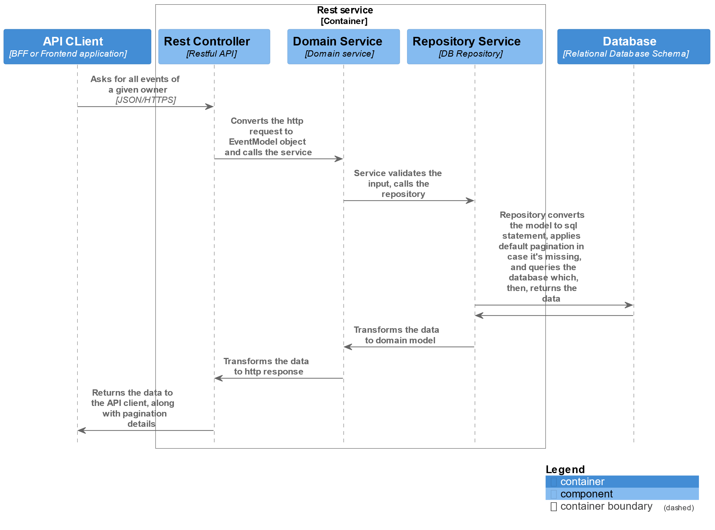
Subtask 1.3 - Flow

Slide 8
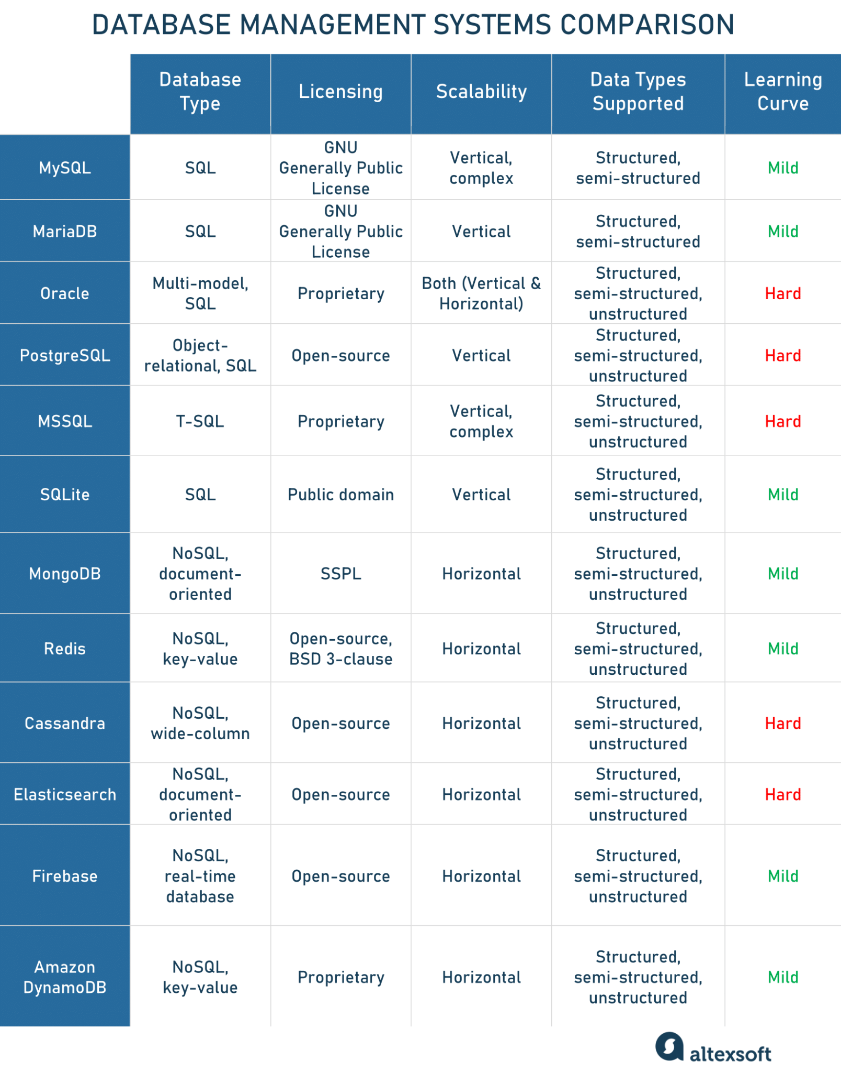
Task 2 – DB Choice
As described previously, the chosen database storage is Postgresql by its resilience, performance, and customizability.
More details on the decision can be seen here (github/marllonsimoes) tech-leadership-prog/blob/main/module-1/decision log.md

Slide 9
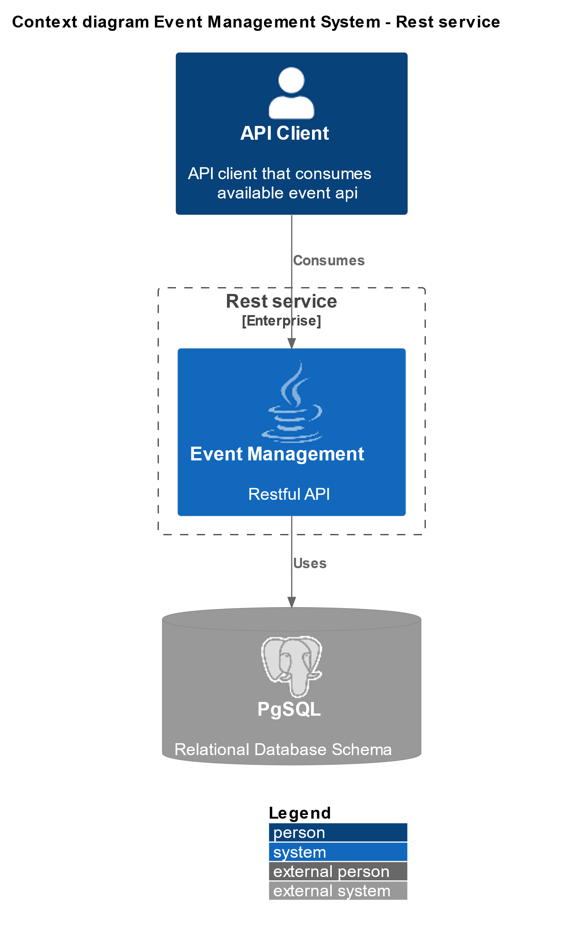
Task 2 (optional) Context

